Slide 1
Security steps for S/4 Hana Migration from ECC

Slide 2
Approaches for migration
Upgrade – Download and Upload Roles to Greenfield S/4 Hana.Just SU25 steps and post-maintain roles with upgraded SU25 entries.
Brownfield – Optimize roles & business processes according to Greenfield S/4 Hana system. Remove inconsistencies between role menu and S_TCODE content. Remove unused tcode and add new ones where needed.
Greenfield – Redesigning all the business processes according to Fiori & S/4 Hana system.

Slide 3
Pre upgrade security checks in ECC
Back up roles by either downloading the roles or creating a transport and exporting it.
Download and backup data from table -AGR_1250,AGR_1251,AGR_TCODES,AGR_USERS,USOBT,USOBX,USOBT_C,USOBX_C etc or have a system copy done prior to the upgrade. For example – AGR_USERS is used when users might say that I had particular access before upgrade.
Download the Simplification list document for the S/4 Hana release.
Download the ST03N data (containing list of transaction codes) for past few months for Fiori App Recommendation Report.

Slide 4
Pre upgrade security checks in S/4 Hana
Check the table PRGN_CORR2 – to find New S/4Hana transaction against old transaction.
Execute the program PROFGEN_CORR_REPORT_2 – This report will give you the list of all tcodes deleted in S/4 Hana which are available in ECC.Step 2D report of SU25.
Review the Simplification list Document for the S/4 Hana release with your business process owners and SMEs.
Check the table in ABLM_BLACKLIST in S/4 Hana for blacklisted transactions, programs, function modules etc.
Have some brainstorming sessions with SMEs as to how you need to handle these changes.
Dual Maintainence for old and new landscape for the changes done after transport.
Refer to SAP Note number 2270335 and 2190137 for getting some idea about transaction codes
Refer to SAP Note number 440231 for SU25 steps.

Slide 5
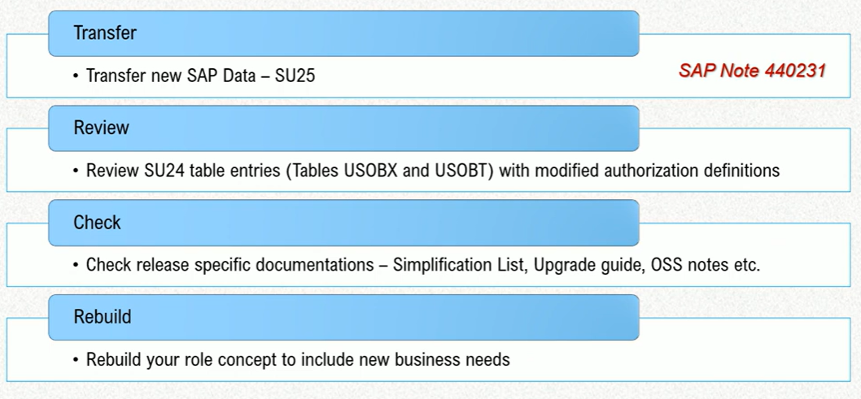
Authorization adjustments due to system conversion

Slide 6
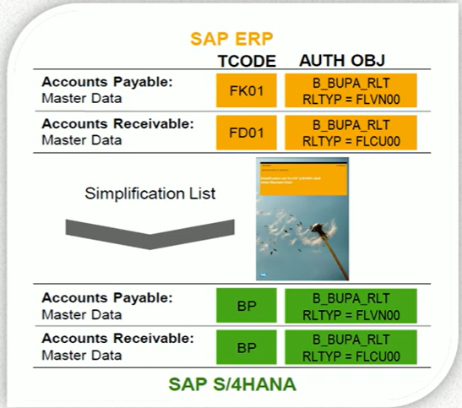
Authorization adjustments due to system conversion
Changes in the authorization object fields.
Transactions are obsolete/replaced.
Authorization objects have been replaced /have become obsolete/new authorization object have been introduced.
Changes in behaviour of non-mandatory fields.

Slide 7
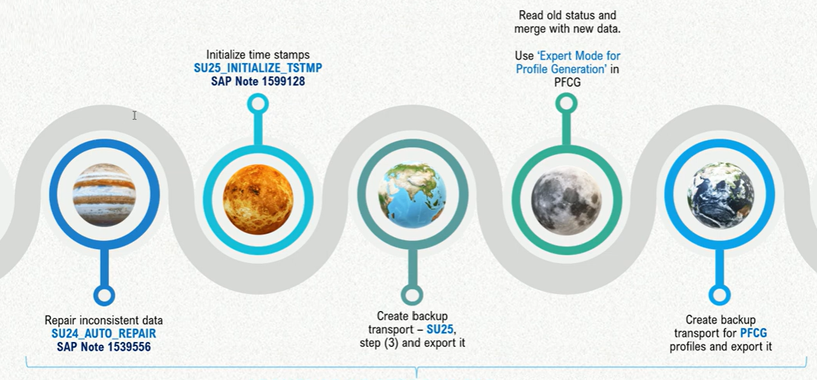
Authorization adjustments due to system conversion

Slide 8
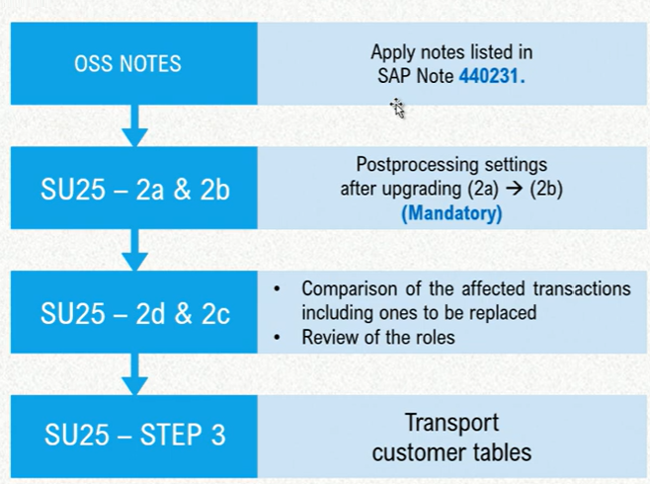
Sequence of steps in s/4 hana

Slide 9
Upgrade steps in GRC
We are currently using GRC 12 SP 5 and need to check the latest SP.
Need to check with SAP if S/4 Hana supports the current GRC version or not. If not, we need to upgrade the GRC SP at least 14 first.
If we upgrade SP in GRC then do we need to upgrade plug-in in satellite systems also as it is currently running into GRC 10.1.
We need to activate Fiori ruleset for GRC.
New connectors needed to be created for HMP,HCP etc.- Check with Basis Team.
Connector name needed to be update in the respective requester/approver roles.
BRF+ Workflow and Mitigation Control Table also needed to be updated.
The complete ruleset needs to be uploaded for the new systems.
Need to make sure the new Fiori apps are included in the ruleset with the combination of semantic object and Odata services. (Ruleset needs to be approved from compliance)
FFIDs needs to configured for new S4 Hana systems.
Background jobs needs to be scheduled in GRC for new systems. (Repository synch, FFID Log etc.
All the roles including new and old, needs to be imported into GRC for new systems.
Cross system ruleset connector needs to be updated with new systems.

Slide 10
Upgrade steps in GRC
Standard Semantic object should be used whenever we create custom catalog due to custom GRC ruleset.
BTP Rise is not in the scope as of now.

Slide 11
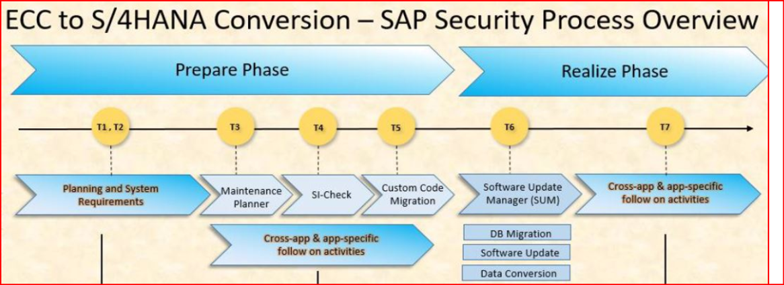

Slide 12
List of QUESTIONS TO CLARIFY AUTHORIZATION REQUIREMENTS
Question | Response | Risk | Recommendation
What is the scope of the S/4 HANA Migration Project? Are we migrating all modules or only specific modules? e.g., Finance, Sales, etc. |  | Migrating all the modules in only one phase will require a lot of effort since we need to identify which process are migrated to Fiori apps. | Migration by specific modules or process.
Is the business expecting to execute the Fiori apps and transactions in the Fiori Portal? |  | Having all the Fiori apps and Tcodes in the Fiori portal could affect the system performance. | As per sap recommendation: No more than five sections on one page. A section should contain between three and seven apps. Ideally, there are not more than 25 apps on the whole page. Remove the unused tcodes to decrease the number of transaction codes in the user menu.

Slide 13
List of QUESTIONS TO CLARIFY AUTHORIZATION REQUIREMENTS
Question | Response | Risk | Recommendation
Will the migration involve any changes to business processes that could impact authorizations? / What new business processes will be introduced? |  | Process changes can impact authorizations which could lead to lack of access. | Inform to the security team when the process changes to identify potential authorization changes.
Are there any changes to the organizational structure like plant, company code, etc.? |  | Need to identify the organizational changes to adapt our security model.
Are there any new specific restrictions or access requirements for sensitive data? |  | Need to know in the initial phase to assess the impact.
How will we handle the migration of custom programs or enhancements that require special authorizations? Will these migrated to S4HANA? Are we using BTP for the business users? |  | Harman has a lot of custom tcodes and custom enhancements that we need to check.

Slide 14
List of QUESTIONS TO CLARIFY AUTHORIZATION REQUIREMENTS
Question | Response | Risk | Recommendation
Which Fiori apps will be used in S4HANA? What are the corresponding business catalogs and authorization objects?
Which interfaces are migrated to S4HANA and which not?

Slide 15
Initial assessments
Identify how many roles/tcodes we have per user. (Maximum, minimum, medium).
Identify action usage (Most and less used tcodes).
Assessment of the transaction codes in our current model that will be replaced by Fiori applications.
Assessment of the obsolete transaction codes in our security model in the sandbox system.
Assessment of the new transaction codes and authorization objects introduced in S4HANA. (S_BTCH_NA1) for example.
Define Naming convention for custom catalogs, spaces and pages.
Review non Z roles (Old Siam roles) that we are still using.

Slide 16
Best Practices, recommendations and notes
Recommendation for Structuring Roles, Spaces and P... - SAP Community
SAP Fiori for SAP S/4HANA – 10 health checks for t... - SAP Community

